Slide 1
What can we know from RREF?
Hung-yi Lee
Notes:
Proof that RREF is unique

Slide 2
Reference
Textbook: Chapter 1.6, 1.7

Slide 3
Outline
RREF v.s. Linear Combination
RREF v.s. Independent
RREF v.s. Rank
RREF v.s. Span

Slide 4
RREF v.s. Linear Combination

Slide 5

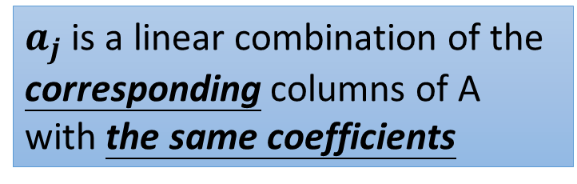

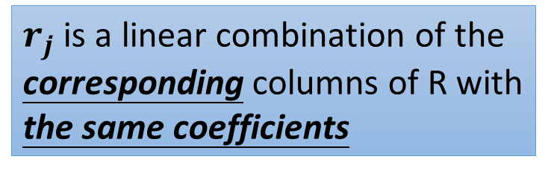
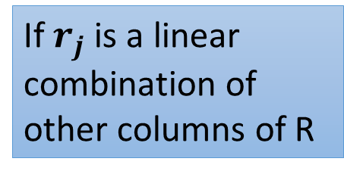
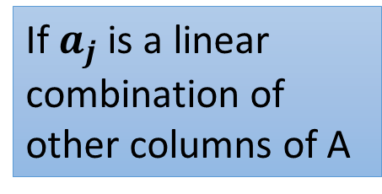
Column Correspondence Theorem
RREF
$$A=\left[\begin{matrix}a_{1} & ⋯ & a_{n}\end{matrix}\right]$$
$$R=\left[\begin{matrix}r_{1} & ⋯ & r_{n}\end{matrix}\right]$$
If $a_{j}$ is a linear combination of other columns of A
$r_{j}$ is a linear combination of the corresponding columns of R with the same coefficients
a₅ = −a₁+a₄
r₅ = −r₁+r₄
$a_{j}$ is a linear combination of the corresponding columns of A with the same coefficients
If $r_{j}$ is a linear combination of other columns of R
a₃ = 3a₁-2a₂
r₃ = 3r₁-2r₂

Slide 6
Column Correspondence Theorem - Example
a₁
a₂
a₃
a₄
a₅
a₆
r₁
r₂
r₃
r₄
r₅
r₆
a₂ = 2a₁
r₂ = 2r₁
a₅ = −a₁+a₄
r₅ = −r₁+r₄
Notes:
P118 – 122 (Chapter 2.3)

Slide 7

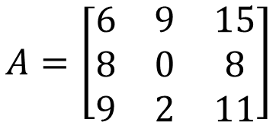
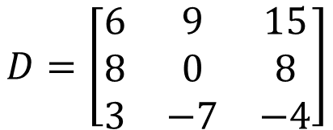
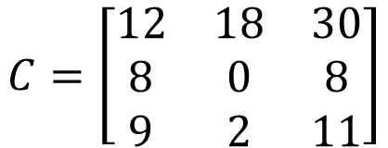
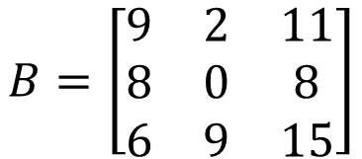



Column Correspondence Theorem – Intuitive Idea
$$a_{1}+a_{2}=a_{3}$$
$$A=\left[\begin{matrix}6 & 9 & 15 \\ 8 & 0 & 8 \\ 9 & 2 & 11\end{matrix}\right]$$
$$d_{1}+d_{2}=d_{3}$$
$$b_{1}+b_{2}=b_{3}$$
$$D=\left[\begin{matrix}6 & 9 & 15 \\ 8 & 0 & 8 \\ 3 & −7 & −4\end{matrix}\right]$$
$$B=\left[\begin{matrix}9 & 2 & 11 \\ 8 & 0 & 8 \\ 6 & 9 & 15\end{matrix}\right]$$
$$c_{1}+c_{2}=c_{3}$$
$$C=\left[\begin{matrix}12 & 18 & 30 \\ 8 & 0 & 8 \\ 9 & 2 & 11\end{matrix}\right]$$
Column Correspondence Theorem (Column 間的承諾)：
就算 row elementary operation 讓 column 變的不同，他們之間的關係永遠不變。

Slide 8
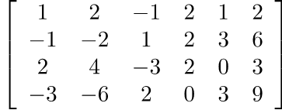
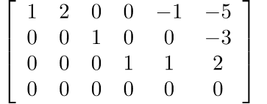






Column Correspondence Theorem – Reason
Before we start:
RREF
Coefficient Matrix:
$$A$$
$$R$$
RREF
Augmented Matrix:
$$\left[\begin{matrix}A & b\end{matrix}\right]$$
$$\left[\begin{matrix}R & b\end{matrix}′\right]$$
$$\left[\begin{matrix}A & b\end{matrix}\right]$$
$$\left[\begin{matrix}R & b′\end{matrix}\right]$$

Slide 9


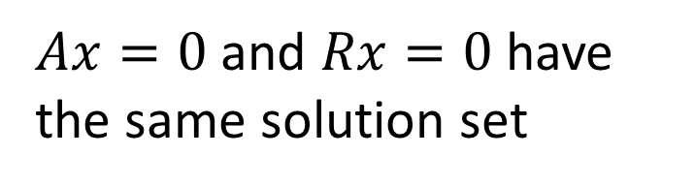

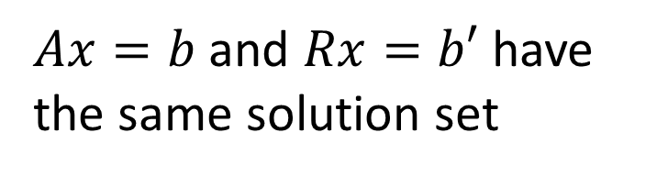
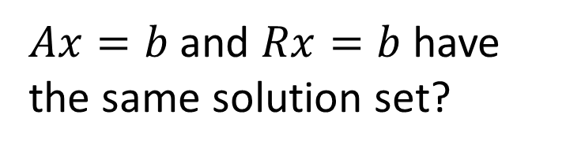

Column Correspondence Theorem – Reason
The RREF of matrix A is R
The RREF of augmented matrix $\left[\begin{matrix}A & b\end{matrix}\right]$ is $\left[\begin{matrix}R & b′\end{matrix}\right]$
The RREF of matrix A is R
$Ax=b$ and $Rx=b$ have the same solution set?
$Ax=b$ and $Rx=b′$ have the same solution set
$Ax=0$ and $Rx=0$ have the same solution set
If $b=0$, then $b′=0$.
Notes:
P120
如果Ax=0，说明Ax之间有linear combination可以互相抵消

Slide 10





Column Correspondence Theorem – Reason
The RREF of matrix A is R, $Ax=0$ and $Rx=0$ have the same solution set
a₁
a₂
a₃
a₄
a₅
a₆
r₁
r₂
r₃
r₄
r₅
r₆
a₂ = 2a₁
$$x=\left[\begin{matrix}\begin{matrix}−2 \\ 1 \\ 0\end{matrix} \\ \begin{matrix}0 \\ 0 \\ 0\end{matrix}\end{matrix}\right]$$
$$x=\left[\begin{matrix}\begin{matrix}−2 \\ 1 \\ 0\end{matrix} \\ \begin{matrix}0 \\ 0 \\ 0\end{matrix}\end{matrix}\right]$$
r₂ = 2r₁
$$Ax=0$$
$$Rx=0$$
-2a₁+a₂=0
-2r₁+r₂=0

Slide 11


Column Correspondence Theorem – Reason
The RREF of matrix A is R, $Ax=0$ and $Rx=0$ have the same solution set
a₁
a₂
a₃
a₄
a₅
a₆
r₁
r₂
r₃
r₄
r₅
r₆
a₅ = −a₁+a₄
$$x=\left[\begin{matrix}\begin{matrix}1 \\ 0 \\ 0\end{matrix} \\ \begin{matrix}−1 \\ 1 \\ 0\end{matrix}\end{matrix}\right]$$
$$x=\left[\begin{matrix}\begin{matrix}1 \\ 0 \\ 0\end{matrix} \\ \begin{matrix}−1 \\ 1 \\ 0\end{matrix}\end{matrix}\right]$$
r₅ = −r₁+r₄
$$Ax=0$$
$$Rx=0$$
a₁-a₄+a₅=0
r₁-r₄+r₅=0

Slide 12
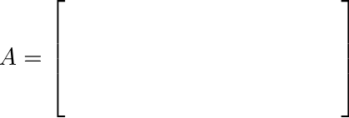
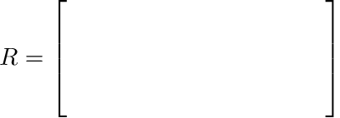










How about Rows?
NO
Are there row correspondence theorem?
$$a_{1}^{T}$$
$$r_{1}^{T}$$
$$a_{2}^{T}$$
$$r_{2}^{T}$$
$$a_{3}^{T}$$
$$r_{3}^{T}$$
$$a_{4}^{T}$$
$$r_{4}^{T}$$
$$Span\left\{a_{1},a_{2},a_{3},a_{4}\right\}$$
=
$$Span\left\{r_{1},r_{2},r_{3},r_{4}\right\}$$
Are they the same?

Slide 13




Span of Columns
$$A=\left[\begin{matrix}a_{1} & ⋯ & a_{6}\end{matrix}\right]$$
$$R=\left[\begin{matrix}r_{1} & ⋯ & r_{6}\end{matrix}\right]$$
$$Span \left\{\begin{matrix}a_{1}, & ⋯ & ,a_{6}\end{matrix}\right\}$$
$$Span \left\{\begin{matrix}r_{1}, & ⋯ & ,r_{6}\end{matrix}\right\}$$
Are they the same?
The elementary row operations change the span of columns.

Slide 14
NOTE
Original Matrix v.s. RREF
Columns:
The relations between the columns are the same.
The span of the columns are different.
Rows:
The relations between the rows are changed.
The span of the rows are the same.
Notes:
Row的信息保持不变

Slide 15
RREF v.s. Independent
Notes:
從 RREF 一眼看出 rank

Slide 16
Column Correspondence Theorem
pivot columns
Leading entries
linear independent
linear independent
The pivot columns are linear independent.

Slide 17
Column Correspondence Theorem
pivot columns
Leading entries
a₂ = 2a₁
a₅ = −a₁+a₄
a₆ = −5a₁−3a₃+2a₄
r₂ = 2r₁
r₅ = −r₁+r₄
r₆ = −5r₁−3r₃+2r₄
The non-pivot columns are the linear combination of the previous pivot columns.
Notes:
非pivot columns也可以linear independent

Slide 18
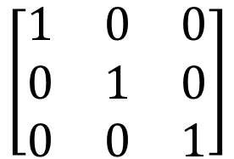
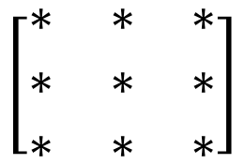
Independent
3X3
All columns are independent
$$\left[\begin{matrix}∗ & ∗ & ∗ \\ ∗ & ∗ & ∗ \\ ∗ & ∗ & ∗\end{matrix}\right]$$
Columns are linear independent
Every column is a pivot column
RREF
Every column in RREF(A) is standard vector.
$$\left[\begin{matrix}1 & 0 & 0 \\ 0 & 1 & 0 \\ 0 & 0 & 1\end{matrix}\right]$$
Identity matrix

Slide 19

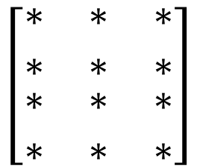
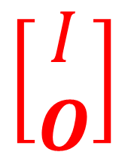
Independent
4X3
$$\left[\begin{matrix}\begin{matrix}∗ & ∗ & ∗ \\ ∗ & ∗ & ∗\end{matrix} \\ \begin{matrix}∗ & ∗ & ∗ \\ ∗ & ∗ & ∗\end{matrix}\end{matrix}\right]$$
All columns are independent
Columns are linear independent
Every column is a pivot column
RREF
Every column in RREF(A) is standard vector.
$$\left[\begin{matrix}\begin{matrix}1 & 0 & 0 \\ 0 & 1 & 0\end{matrix} \\ \begin{matrix}0 & 0 & 1 \\ 0 & 0 & 0\end{matrix}\end{matrix}\right]$$
$$\left[\begin{matrix}I \\ O\end{matrix}\right]$$

Slide 20
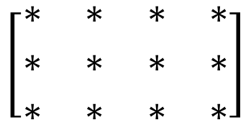

Independent
3X4
All columns are independent
$$\left[\begin{matrix}\begin{matrix}∗ & ∗ \\ ∗ & ∗ \\ ∗ & ∗\end{matrix} & \begin{matrix}∗ & ∗ \\ ∗ & ∗ \\ ∗ & ∗\end{matrix}\end{matrix}\right]$$
Columns are linear independent
Every column is a pivot column
RREF
Cannot be a pivot column
Every column in RREF(A) is standard vector.
$$\left[\begin{matrix}\begin{matrix}1 & 0 \\ 0 & 1 \\ 0 & 0\end{matrix} & \begin{matrix}0 & ∗ \\ 0 & ∗ \\ 1 & ∗\end{matrix}\end{matrix}\right]$$

Slide 21

Independent
因為太胖了，自己走不動
$$\left[\begin{matrix}\begin{matrix}∗ & ∗ \\ ∗ & ∗ \\ ∗ & ∗\end{matrix} & \begin{matrix}∗ & ∗ \\ ∗ & ∗ \\ ∗ & ∗\end{matrix}\end{matrix}\right]$$
The columns are dependent
(矮胖型)
Dependent or Independent?
More than 3 vectors in R³ must be dependent.
More than m vectors in R^{m} must be dependent.

Slide 22
Independent – Intuition
Notes:
Matrix看作一个function，有一个功能是转变input和output的信息维度
n_row < n_col 时（矮胖），是一个将信息从高维压缩到低维的过程
如果有解的话，低维信息没法完全还原到高维空间的某个位置（损失了信息），在多出来的那个维度是不确定的

Slide 23
RREF v.s. Rank
Notes:
從 RREF 一眼看出 rank

Slide 24


Rank
Maximum number of Independent Columns
$$=$$
3
Rank = ?
Number of Pivot Column
$$=$$
Number of Non-zero rows
Rank = ?
3

Slide 25


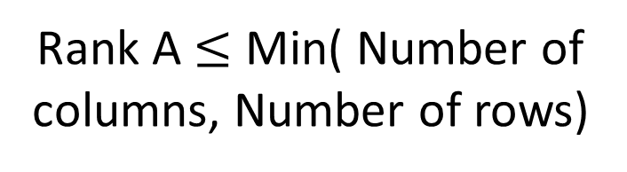
Properties of Rank from RREF
Maximum number of Independent Columns
Rank A $≤$ Number of columns
$$=$$
Number of Pivot Column
Rank A $≤$ Min( Number of columns, Number of rows)
$$=$$
Number of Non-zero rows
Rank A $≤$ Number of rows

Slide 26
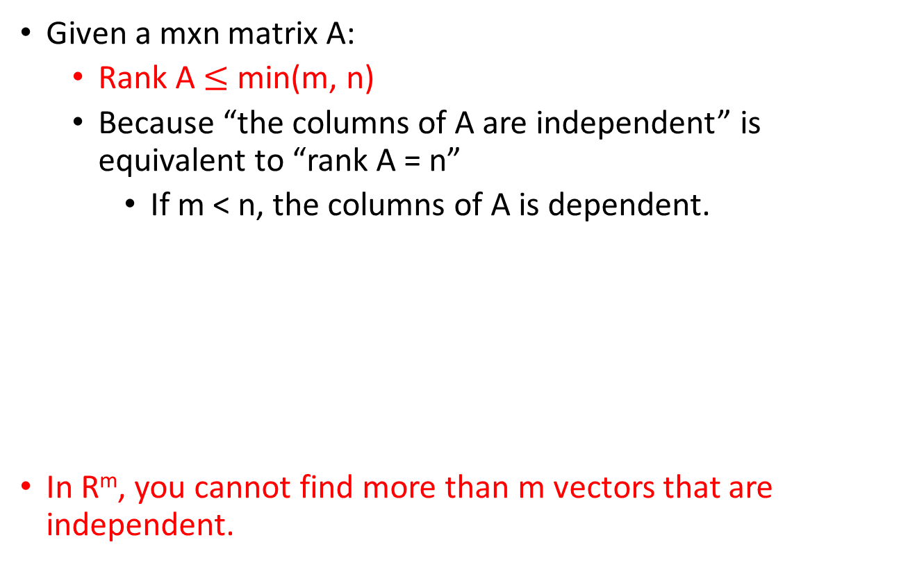

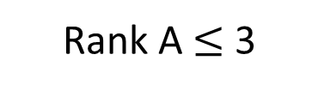

Properties of Rank from RREF
Matrix A is full rank if Rank A = min(m,n)
Given a mxn matrix A:
Rank A $≤$ min(m, n)
Because “the columns of A are independent” is equivalent to “rank A = n”
If m < n, the columns of A is dependent.
In R^{m}, you cannot find more than m vectors that are independent.
$$\left[\begin{matrix}\begin{matrix}∗ & ∗\end{matrix} & \begin{matrix}∗ & ∗\end{matrix} \\ \begin{matrix}∗ & ∗\end{matrix} & \begin{matrix}∗ & ∗\end{matrix} \\ \begin{matrix}∗ & ∗\end{matrix} & \begin{matrix}∗ & ∗\end{matrix}\end{matrix}\right]$$
$$\left\{\left[\begin{matrix}∗ \\ ∗ \\ ∗\end{matrix}\right],\left[\begin{matrix}∗ \\ ∗ \\ ∗\end{matrix}\right],\left[\begin{matrix}∗ \\ ∗ \\ ∗\end{matrix}\right],\left[\begin{matrix}∗ \\ ∗ \\ ∗\end{matrix}\right]\right\}$$
3 X 4
A matrix set has 4 vectors belonging to R³ is dependent
Rank A $≤$ 3
Notes:
未看先猜

Slide 27


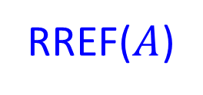


Basic, Free Variables v.s. Rank
3 useful
equations
$$Ax=b$$
$$A$$
$$b$$
RREF($A$)
$$b’$$
rank
=
non-zero row
=
3 basic variables
No. column –non-zero row
nullity
=
=
2 free variables
Notes:
The rank of [A b] is the number of “useful” equations in the system of linear equations Ax = b (i.e., the number of nonzero rows in [R c]).
The rank of A represents the number of basic variables while the nullity of A is the number of free variables.

Slide 28
Rank
Rank
Maximum number of Independent Columns
Number of Pivot Column
Number of Non-zero rows of RREF
Number of Basic Variables
Nullity = no. column - rank
Number of zero rows
of RREF
Number of Free Equations
Notes:
One of the statement is fake!!!!!!!!!!!!!!
因为是col的数量减去rank，和row无关，要用col的数量去减

Slide 29
RREF v.s. Span
Notes:
從 RREF 一眼看出 rank

Slide 30

Consistent or not
Given Ax=b, if the reduced row echelon form of [ A b ] is
Given Ax=b, if the reduced row echelon form of [ A b ] is
Consistent
b is in the span of the columns of A
inconsistent
b is NOT in the span of the columns of A
$$0∙x_{1}+0∙x_{2}+0∙x_{3}=1$$

Slide 31



Consistent or not
Ax =b is inconsistent (no solution)
The RREF of [A b] is
$$\left[\begin{matrix}\begin{matrix}∗ & ∗ & ∗ \\ ∗ & ∗ & ∗ \\ ∗ & ∗ & ∗\end{matrix} & \begin{matrix}∗ & ∗ & ∗ \\ ∗ & ∗ & ∗ \\ ∗ & ∗ & ∗\end{matrix} \\ \begin{matrix}0 & 0 & 0 \\ 0 & 0 & 0 \\ 0 & 0 & 0\end{matrix} & \begin{matrix}0 & 0 & d \\ 0 & 0 & 0 \\ 0 & 0 & 0\end{matrix}\end{matrix}\right]$$
Only the last column is non-zero
$$d≠0$$
Rank A $≠$ rank [A b]
Need to know b

Slide 32
Consistent or not
Ax = b is consistent for every b
RREF of [A b] cannot have a row whose only non-zero entry is at the last column
RREF of A cannot have zero row
Rank A = no. of rows

Slide 33
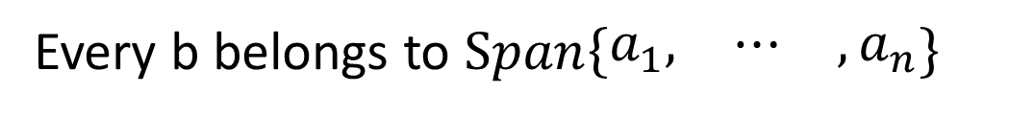
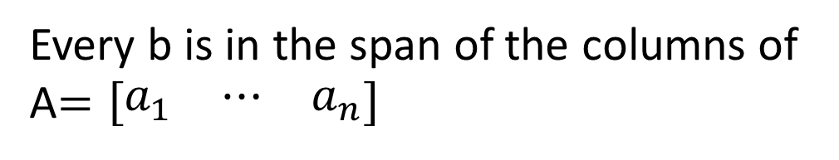


Consistent or not
e.g.
$$\left[\begin{matrix}\begin{matrix}∗ & ∗\end{matrix} & \begin{matrix}∗ & ∗\end{matrix} \\ \begin{matrix}∗ & ∗\end{matrix} & \begin{matrix}∗ & ∗\end{matrix} \\ \begin{matrix}∗ & ∗\end{matrix} & \begin{matrix}∗ & ∗\end{matrix}\end{matrix}\right]$$
3 independent columns
Ax =b is consistent for every b
Rank A = no. of rows
Every b is in the span of the columns of A$=\left[\begin{matrix}a_{1} & ⋯ & a_{n}\end{matrix}\right]$
Every b belongs to $Span\left\{\begin{matrix}a_{1}, & ⋯ & ,a_{n}\end{matrix}\right\}$
$Span\left\{\begin{matrix}a_{1}, & ⋯ & ,a_{n}\end{matrix}\right\}=R^{m}$
m independent vectors can span $R^{m}$
More than m vectors in R^{m} must be dependent.

Slide 34


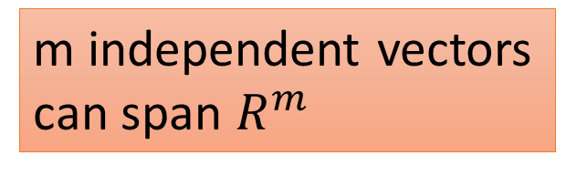

m independent vectors can span $R^{m}$
More than m vectors in R^{m} must be dependent.
$$a$$
Consider R²
$$b$$
$$c$$
yes
independent

Slide 35


Full Rank: Rank = n & Rank = m
1
0
$$\left[\begin{matrix}\begin{matrix}∗ & ∗ & ∗ \\ ∗ & ∗ & ∗ \\ ⋮ & ⋮ & ⋮\end{matrix} & \begin{matrix}∗ & ∗ & ∗ \\ ∗ & ∗ & ∗ \\ ⋮ & ⋮ & ⋮\end{matrix} \\ \begin{matrix}⋮ & ⋮ & ⋮ \\ ∗ & ∗ & ∗ \\ ∗ & ∗ & ∗\end{matrix} & \begin{matrix}⋮ & ⋮ & ⋮ \\ ∗ & ∗ & ∗ \\ ∗ & ∗ & ∗\end{matrix}\end{matrix}\right]$$
The size of A is mxn
0
1
Rank A = n
A is square or 高瘦
0
0
0
0
Ax = b has at most one solution
The columns of A are linearly independent.
$$\left[\begin{matrix}I \\ O\end{matrix}\right]$$
All columns are pivot columns.
RREF of A:
Notes:
把高维信息降成低维，A的表示能力不会不够，因此不存在无限解，要么能表达，要么不能。

Slide 36
Full Rank: Rank = n & Rank = m
1
$$\left[\begin{matrix}\begin{matrix}∗ & ∗ & ∗ \\ ∗ & ∗ & ∗ \\ ⋮ & ⋮ & ⋮\end{matrix} & \begin{matrix}∗ & ∗ & ∗ \\ ∗ & ∗ & ∗ \\ ⋮ & ⋮ & ⋮\end{matrix} \\ \begin{matrix}⋮ & ⋮ & ⋮ \\ ∗ & ∗ & ∗ \\ ∗ & ∗ & ∗\end{matrix} & \begin{matrix}⋮ & ⋮ & ⋮ \\ ∗ & ∗ & ∗ \\ ∗ & ∗ & ∗\end{matrix}\end{matrix}\right]$$
The size of A is mxn
0
1
Rank A = m
A is square or 矮胖
0
0
0
1
0
0
0
0
1
Every row of R contains a pivot position (leading entry).
Ax = b always have solution (at least one solution) for every b in R^{m}.
The columns of A generate R^{m}.
Notes:
把低维信息提高到高维，因为A的表示能力不够，所以不能很好表达， 有些低维度不能表达的就可以随意取值。

